Slide 1
HR Analytics Project Employee Attrition Analysis
Tools Used: Excel | SQL | Power BI |Tableau
Dataset: HR_1 & HR_2
Prepared by: Sarthak Bhambri
Vishram Dalvi
Priyanka Sahu
Salman Nadeem

Slide 2
BUSINESS PROBLEM STATEMENT
Business Problem
Employee attrition increases hiring and training costs
High attrition negatively impacts productivity and morale
HR teams often lack clear, data-driven insights into attrition drivers
Objective
To analyze HR data and identify key factors responsible for employee attrition using analytics and dashboards.

Slide 3
PROJECT OVERVIEW
Project Overview
Domain: Human Resource Analytics
Project Type: Analytical Dashboard Project
Focus Area: Employee Attrition & Retention
Final Output: Interactive HR Analytics Dashboard

Slide 4
DATASET OVERVIEW
Dataset Description
Dataset Name: HR_1 and HR_2
Dataset Type: Excel
Records: ~50,000 records per dataset
Data Structure: Structured employee-level data
Data Includes
Employee demographics
Job roles and departments
Salary and compensation details
Work-life balance indicators
Attrition status

Slide 5
DATA CLEANING & PREPARATION
Data Cleaning Steps
Removed encoding issues from column names
Corrected incorrect data types (Age, Income, Experience)
Checked and handled null values
Ensured consistency across both datasets
Merged HR_1 and HR_2 into a unified dataset
Note
Clean data was critical to ensure accurate KPI calculations.

Slide 6
DATA MODELING & DERIVED FIELDS
Data Modeling Approach
Created a single unified employee dataset
Prepared data for KPI analysis
Built derived fields to support business questions
Derived Fields
Attrition Flag (Yes = 1, No = 0)
Total Employee Count
Active Employee Count
Attrition Rate (%)

Slide 7
MEASURES & CALCULATIONS USED
Key Measures Created
Total Employees
Attrition Count
Attrition Rate (%)
Average Monthly Income
Average Hourly Rate
Average Working Years
Important
Measures were used instead of calculated columns to ensure dynamic calculations based on filters and slicers.

Slide 8
KPI OVERVIEW
Key Performance Indicators
Average Attrition Rate for all Departments
Average Hourly Rate of Male Research Scientist
Attrition Rate vs Monthly Income
Average Working Years for each Department
Job Role vs Work-Life Balance
Attrition Rate vs Years Since Last Promotion

Slide 9
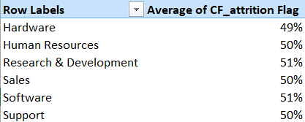
KPI 1 – ATTRITION RATE BY DEPARTMENT
Purpose
Comparison of attrition across departments
Identification of high-risk departments
Insight
Certain departments show consistently higher attrition

Slide 10
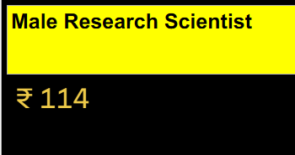
KPI 2 – HOURLY RATE ANALYSIS
Purpose
Analyze role-based compensation trends
Insight
Hourly rates vary significantly across departments

Slide 11
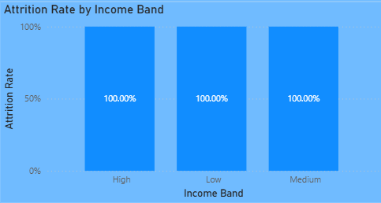
KPI 3 – ATTRITION VS MONTHLY INCOME
Purpose
Understand relationship between income and attrition
Insight
Lower income bands show higher attrition rates

Slide 12
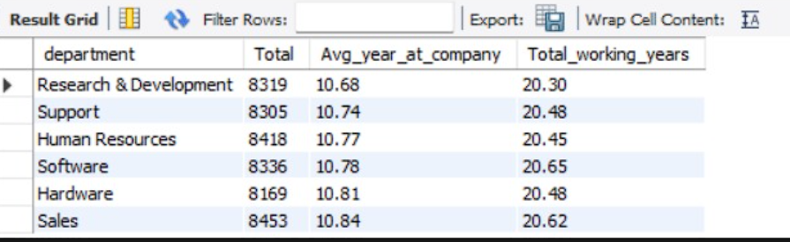
KPI 4 – AVERAGE WORKING YEARS
Purpose
Measure employee tenure across departments
Insight
Higher average working years correlate with lower attrition

Slide 13
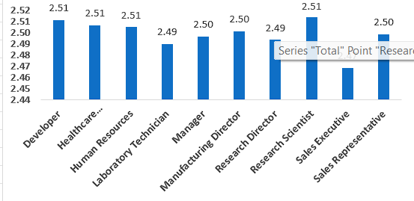
KPI 5 – JOB ROLE VS WORK-LIFE BALANCE
Purpose
Analyze work-life balance across job roles
Insight
Poor work-life balance increases attrition risk

Slide 14
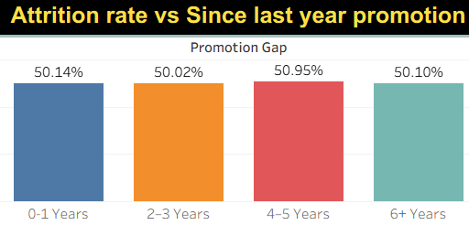
KPI 6 – ATTRITION VS PROMOTION
Purpose
Evaluate impact of promotions on attrition
Insight
Employees without recent promotions are more likely to leave

Slide 15
DASHBOARD OVERVIEW
Interactive HR Attrition Dashboard
Combines all KPIs into a single view
Interactive filters by department, job role, and gender
Enables HR teams to explore attrition patterns

Slide 16
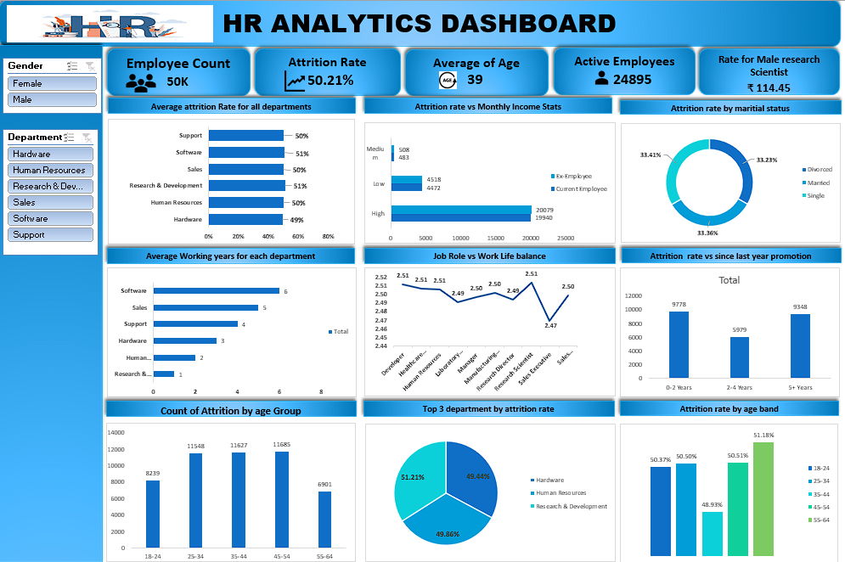
EXCEL DASHBOARD

Slide 17
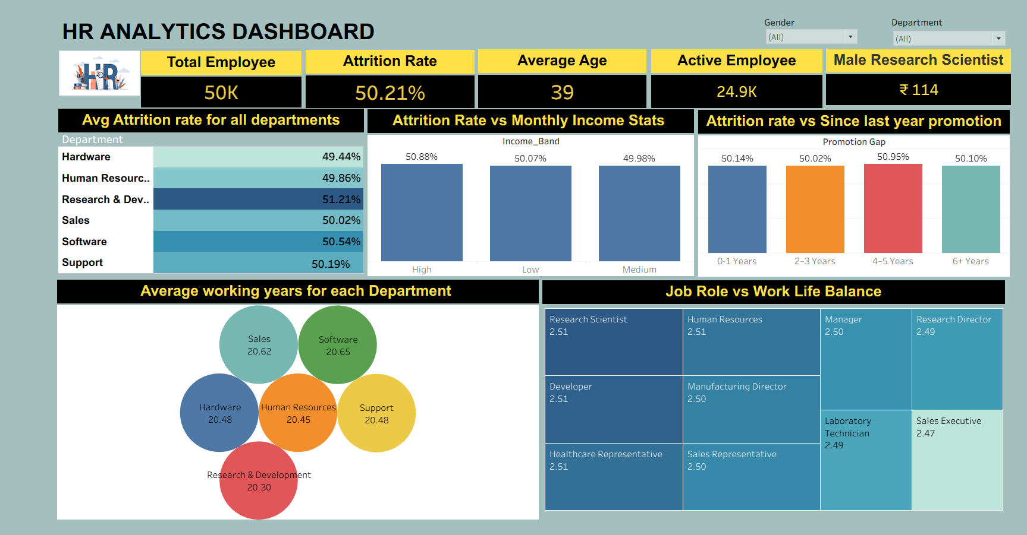
TABLEAU DASHBOARD

Slide 18
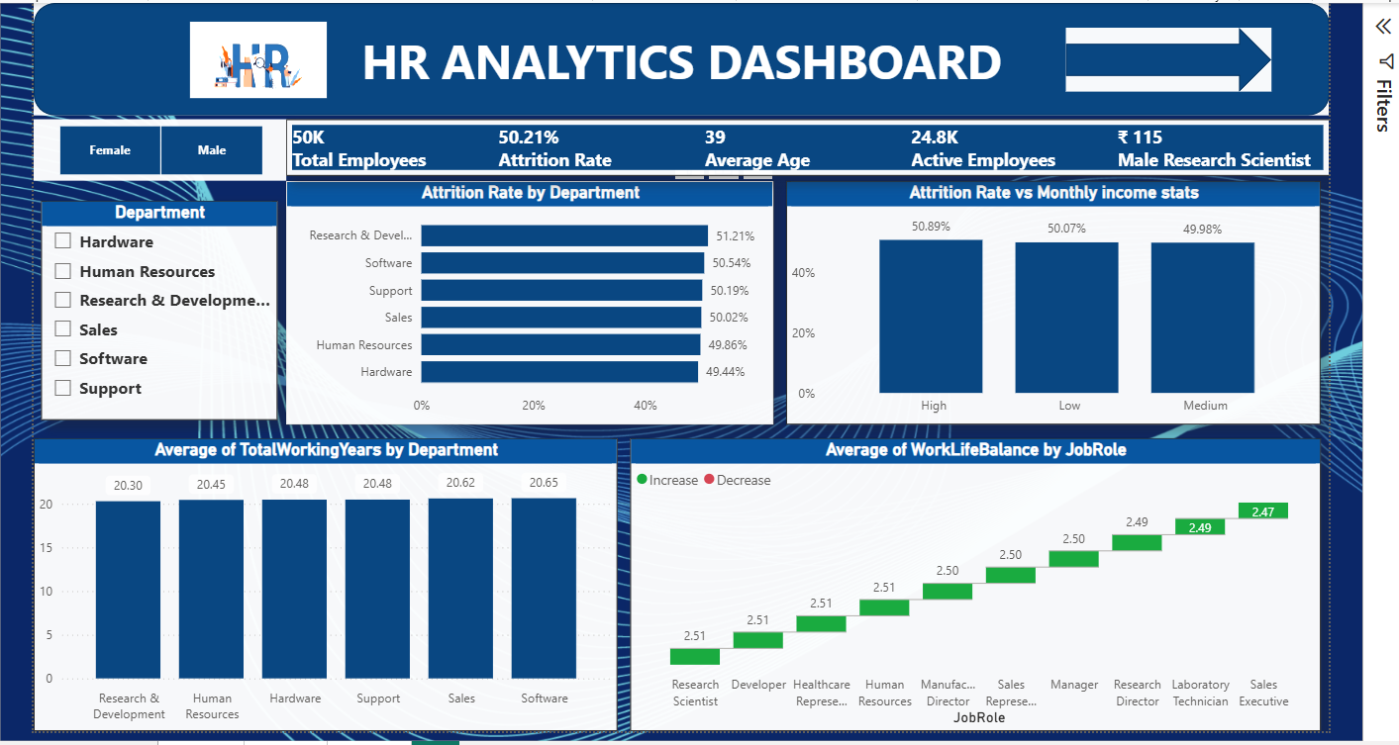
POWER BI DASHBOARD

Slide 19
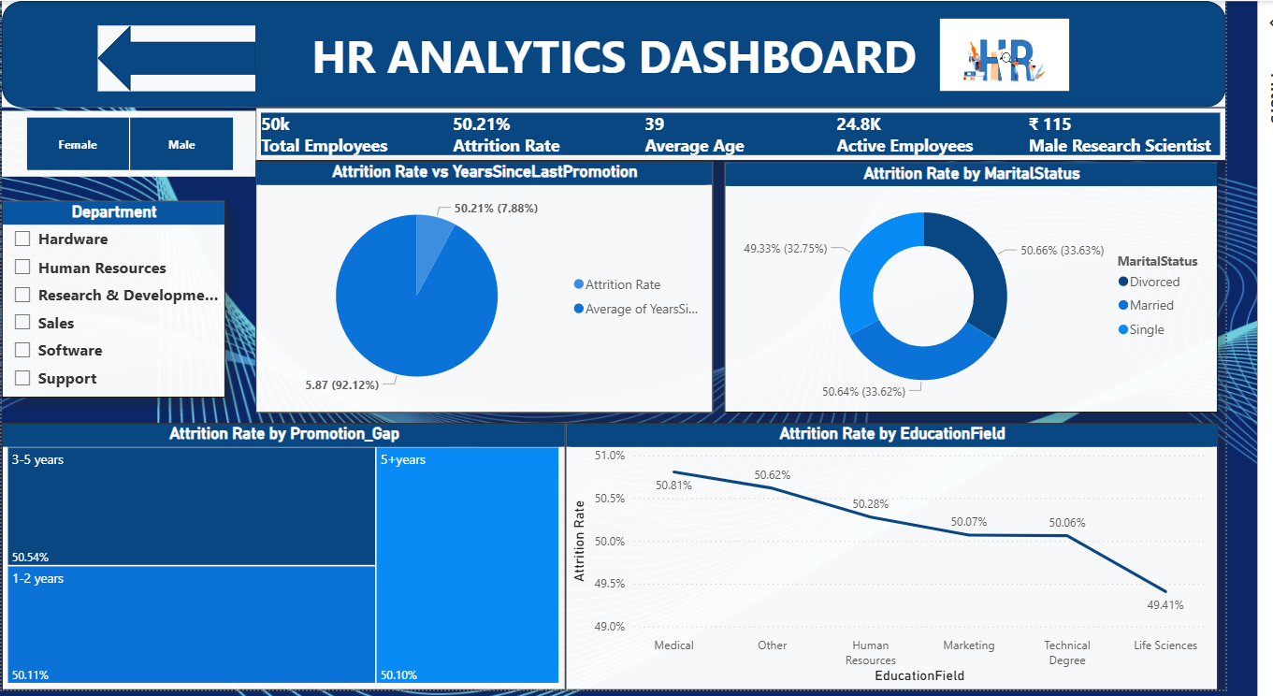
POWER BI DASHBOARD

Slide 20
BUSINESS IMPACT
Business Impact
Enables data-driven HR decision-making
Identifies high-risk employee segments
Improves employee retention strategies
Reduces hiring and training costs

Slide 21
CHALLENGES FACED
Challenges Encountered
Handling large datasets
Data inconsistencies between HR_1 and HR_2
Choosing between calculated columns and measures
Selecting meaningful KPIs
Optimizing dashboard performance

Slide 22
LEARNINGS & SKILLS GAINED
Key Learnings
End-to-end analytics workflow
Importance of data cleaning
KPI-driven business analysis
Dashboard design and storytelling
Practical HR analytics exposure

Slide 23
CONCLUSION
This analysis demonstrates how HR connects compensation, tenure, promotions, and work-life balance to attrition, offering actionable insights for workforce stability and recruiter decision making.

Slide 24
THANK YOU

